Slide 1
Chapter Six
Dive Accident Management

Slide 2
Topics In This Chapter
Dive Site Organization
Assessing the Diver’s Injuries
Basic Life Support
Secondary Assessment
Field Neurological Exam
Shock
On-Scene Oxygen Therapy
Hypothermia
Hyperthermia

Slide 3
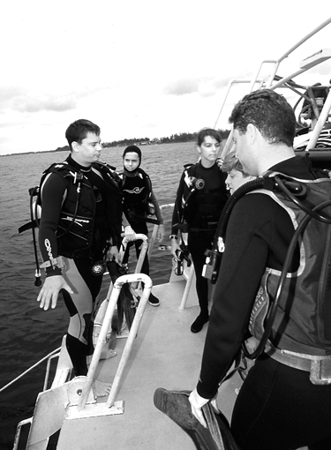
Dive Site Organization
The advantage of organization
Security of knowing that all support persons are practiced and rehearsed in their roles

Slide 4
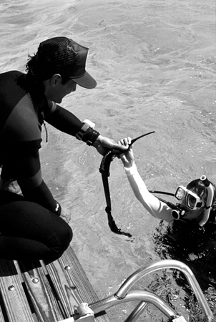
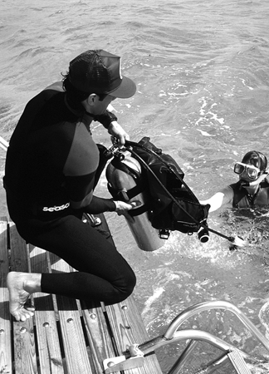
Dive Site Organization
Personnel
On-site: may include instructors, divemasters, divers
Off-site: public safety / emergency response dive team

Slide 5
Dive Site Organization
Role of rescue team leader
Initiate the recall signal, to bring all divers back
Assemble rescue and emergency gear
Assign rescue divers to assist victim in water
Assign someone to begin recording events, times, and related information
Assign someone to summon additional assistance

Slide 6
Dive Site Organization
Appropriate behavior of rescuers
Respect the dignity of the victim
Avoid making a fuss about minor incidents
Do not talk about victim in third person in front of others; use his name
Stay calm and reassure the victim; remember that even an unconscious person may hear every word that is said, and the victim’s mental state may be important to his survival
Be gentle with other people at the scene

Slide 7
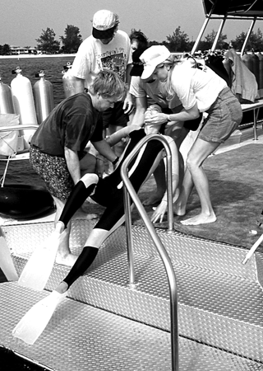
Dive Site Organization
The four R’s of accident management
Recognize
Respond
Rescue
Record

Slide 8
Assessing the Diver’s Injuries
Scene survey
Is there any danger to the rescuer or victim ?
Should the victim be moved ?

Slide 9
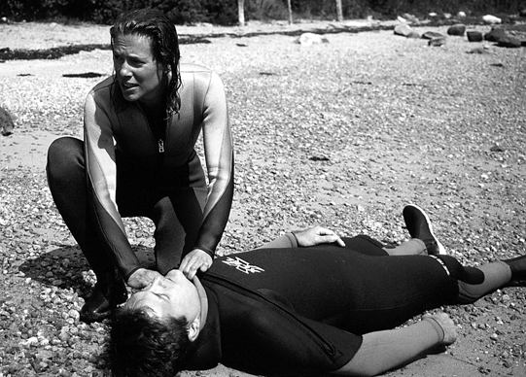
Assessing the Diver’s Injuries
Primary survey – the ABC’s
Airway: open and unobstructed
Breathing: look, listen and feel for signs of respiration
Circulation: carotid pulse, or other signs of life

Slide 10
Basic Life Support
Rescue breathing – out of the water
Head tilt / chin lift
Administer two full initiating breaths
If circulation exists, continue with one breath every five seconds

Slide 11
Basic Life Support
Blocked airway
First, reposition head and again try rescue breathing
Then, if blockage continues . . .
Visually check for obstructions
Use finger sweep
Administer abdominal thrusts

Slide 12
Basic Life Support
One rescuer CPR – Rule of 2’s
Give two full breaths
Blow for two seconds
Stack two hands, up two fingers on sternum
Compress two inches (5 cm)
Compress almost two times per second
Compress 15 times, and repeat
After four cycles (about one minute) check for respiration and pulse

Slide 13
Basic Life Support
Alternate CPR recommendations
Some authorities now suggest a rhythm of 30 compressions followed by two breaths
Some authorities also suggest that compressions should be started immediately, if respiration is absent (without checking for pulse)

Slide 14
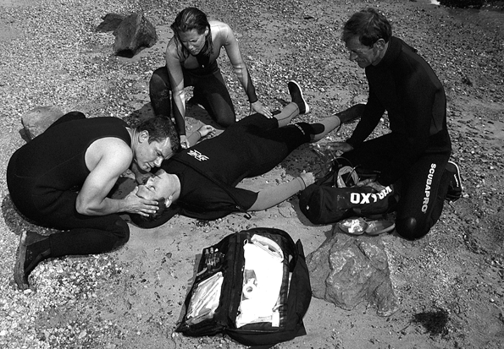
Secondary Assessment
When respiration and circulation are
present . . .
Rescuer then may proceed with further injury assessment, and render appropriate care

Slide 15
Secondary Assessment
Vital signs – periodically check and record
Respiration: normal is 10 to 20 breaths per minute, and effortless
Pulse: normal is 50 to 90 beats per minute, and steady
Skin color, temperature and moisture: skin, nail beds, and inside of eyelids should be pink; skin should be warm and dry

Slide 16
Secondary Assessment
Level of consciousness
“Alert and oriented” – patient is fully conscious and aware of surroundings
“Responds to verbal stimuli” – patient answers questions, though may be confused
“Responds to painful stimuli” – patient cannot speak, but responds to pinching
“Unresponsive” – patient will not respond to any stimuli, and is fully unconscious

Slide 17
Secondary Assessment
Patient evaluation
Start at head, then neck, torso, arms, abdomen, and legs
Check for bleeding, fractures, tenderness, and other apparent abnormalities

Slide 18
Five-Minute Field Neuro Exam
Perform immediately if DCI is suspected,
then repeat periodically if medical
attention is delayed
Look for deviations from the expected norm
Look for differences, one side versus the other
Look for changes over time

Slide 19
Five-Minute Field Neuro Exam
Orientation
Ask patient his/her name, age, the location, date, and/or approximate time of day
Evaluate overall alertness

Slide 20
Five-Minute Field Neuro Exam
Eyes
Ask patient to track your moving finger (with both eyes open), and evaluate uniform and fluid movement of eyes
Check pupil size and reaction to light
Inquire about blurred vision or other visual disturbances

Slide 21
Five-Minute Field Neuro Exam
Forehead
Check sensation, in response to touch
Ask patient to raise and lower eyebrows, and evaluate uniform movement

Slide 22
Five-Minute Field Neuro Exam
Face
Ask patient to whistle, smile and/or clench teeth
Evaluate uniform movement of facial muscles
Check for equal tension in jaw muscles

Slide 23
Five-Minute Field Neuro Exam
Ears
With patient’s eyes closed, rub your fingers together and determine distance from each ear that patient hears this sound
Inquire about ringing in ears or other hearing disturbances

Slide 24
Five-Minute Field Neuro Exam
Gag reflex
Ask patient to swallow
Observe movement of Adam’s apple and/or neck muscles
Watch for any difficulty

Slide 25
Five-Minute Field Neuro Exam
Tongue
Ask patient to stick out tongue
Watch for any drooping or one-sided tendency

Slide 26
Five-Minute Field Neuro Exam
Shoulders
Check sensation, in response to touch
Ask patient to raise shoulders against resistance, and compare muscle strength

Slide 27
Five-Minute Field Neuro Exam
Arms & Hands
Check sensation, in response to touch
Ask patient to move arms against resistance, and also ask patient to squeeze your hands, compare muscle strength

Slide 28
Five-Minute Field Neuro Exam
Chest
Check sensation, in response to touch
Observe general breathing pattern
Inquire about any difficulty or discomfort

Slide 29
Five-Minute Field Neuro Exam
Legs
Check sensation, in response to touch
Ask patient to move legs against resistance, and compare muscle strength

Slide 30
Five-Minute Field Neuro Exam
Heel-to-toe walk
Observe patient’s balance and coordination (use caution, or omit this exercise completely, on a moving boat)

Slide 31
Five-Minute Field Neuro Exam
First aid for suspected DCI
Activate EMS / seek medical attention
Have patient lie down (left side preferred)
Administer oxygen
Provide fluids, if conscious
Monitor patient
Treat for shock
CPR when appropriate

Slide 32
Shock
What is it ?
Radical drop in body’s fluid levels
May be caused by considerable loss of blood (internally or externally), or by loss of other fluids through profuse sweating and vomiting
Also may be caused by any injury or trauma, which triggers dilation of blood vessels and thus significantly reduces blood pressure
The body is unable to transport sufficient blood, and oxygen, to all tissues
The brain switches circulation away from other tissues and directs it to itself, the heart and lungs

Slide 33
Shock
First aid
Calm and reassure the patient
Determine and treat the cause of the shock reaction
Victim should be placed on his back with his feet slightly elevated (if no head or spine injury)
Remove wetsuit hood and loosen suit
Closely monitor vitals signs, and watch for vomiting
Maintain an open airway
Administer oxygen
Activate EMS / seek medical attention

Slide 34
On-Scene Oxygen Therapy
Benefits of oxygen
May diminish the size of nitrogen bubbles in DCS, easing pains and diminishing long term tissue damage
May reduce the size of air bubbles in AGE, and help preserve tissues cut off from direct blood flow

Slide 35
On-Scene Oxygen Therapy
Nasal cannula
Tube-like device, used to deliver oxygen to nostrils
Constant flow
Flow should be set at 15 litres per minute
Delivers only about 30% to 40% oxygen to patient

Slide 36
On-Scene Oxygen Therapy
Non-rebreather mask
Mask covers patient’s mouth and nose
Has an attached reservoir bag
Constant flow
Flow should be set at 15 litres per minute (increase flow to 25 litres per minute, if bag completely deflates upon patient’s inhalation)
Delivers about 70% to 90% oxygen to patient

Slide 37
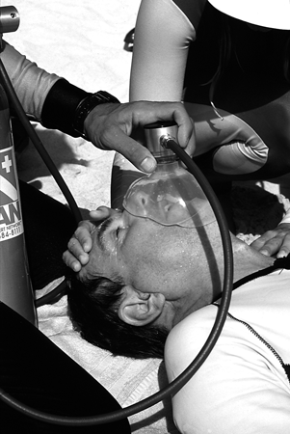
On-Scene Oxygen Therapy
Demand-type system
Close-fitting mask, with demand regulator
Intermittent flow, only upon patient’s inhalation
Mask covers patient’s mouth and nose
Delivers 100% oxygen to patient

Slide 38
Hypothermia
Possible signs and symptoms
Shivering violently
Somewhat cyanotic
Slurred speech
Difficulty walking
Weakness

Slide 39
Hypothermia
First aid
Gradually warming of patient
Administer fluids, including warm fluids
Light physical activity
Administer oxygen, if cyanotic or exhibiting respiratory distress

Slide 40
Hyperthermia
Signs and symptoms of heat exhaustion
Muscle cramps
Dizziness
Overwhelming tiredness
Weakness

Slide 41
Hyperthermia
First aid for heat exhaustion
Cool the patient
Remove exposure suit (or loosen clothing)
Administer fluids
Administer oxygen, if exhibiting respiratory distress

Slide 42
Hyperthermia
Signs and symptoms of heat stroke
Listless and/or unresponsive
Rapid and stronger than normal pulse (bounding)
Rapid breathing
Skin is hot, red, and dry

Slide 43
Hyperthermia
First aid for heat stroke
Immediately cool the patient as quickly as possible
Remove exposure suit (or loosen clothing)
Administer fluids if conscious
Administer oxygen
Treat for shock

Slide 44
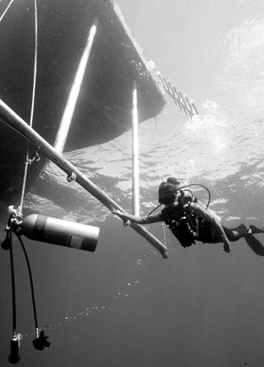
Summary
Dealing with dive emergencies
Recognize, respond, rescue, and record
Assess the victim’s injuries
Render appropriate first aid, including oxygen

Slide 45
Scuba I.Q. Review

Slide 46
Scuba IQ Review
1
Q
Why is good, general dive site organization a benefit in the event of a diving accident?
A
The security of knowing that all support persons are practiced and rehearsed in their roles

Slide 47
Scuba IQ Review
2
Q
List and explain the four R’s of the emergency plan.
A
Recognize
Respond
Rescue
Record

Slide 48
Scuba IQ Review
3
Q
Who is the most important person on the accident scene?
A
You are the most important person on the accident scene

Slide 49
Scuba IQ Review
4
Q
What is meant by the A, B, C’s of the Primary Survey?
A
Airway
Breathing
Circulation

Slide 50
Scuba IQ Review
5
Q
What are the indications that CPR should be begun on a diving accident victim?
A
You have established that the victim is not breathing, and has no pulse or other signs of life

Slide 51
Scuba IQ Review
6
Q
What will we measure and record on the Secondary Survey?
A
Vital signs
Level of consciousness
Patient evaluation

Slide 52
Scuba IQ Review
7
Q
Describe the steps in a field neurological examination.
A
Orientation
Muscle Strength
Eyes
Sensory
Swallowing reflex

Slide 53
Scuba IQ Review
8
Q
How often should the Secondary Survey and neuro exam be repeated?
A
Every 15 minutes

Slide 54
Scuba IQ Review
9
Q
What is shock and how do we treat it?
A
Shock: Because of loss of fluids, the body is unable to provide blood and oxygen to all tissues; the brain then switches circulation away from the other tissues and directs it only to itself, the heart and lungs

Slide 55
Scuba IQ Review
9
Q
What is shock and how do we treat it?
A
Treatment: Calm and reassure the patient, determine and treat the cause of the shock reaction, victim should be placed on his back with his feet slightly elevated, remove wetsuit hood and loosen suit, monitor vitals closely, maintain an open airway and watch for vomiting, give oxygen and get help

Slide 56
Scuba IQ Review
10
Q
Why is oxygen therapy so valuable in treating diving injuries?
A
Oxygen may diminish the size of nitrogen bubbles in DCS, easing pains and diminishing long term tissue damage; it can also reduce the size of air bubbles in AGE, as well as help preserve tissue cut off from direct blood flow

Slide 57
Scuba IQ Review
11
Q
List and describe the main methods of delivering oxygen to the patient.
A
Nasal cannula
Non-rebreather mask with reservoir bag
Demand type regulator

Slide 58
Scuba IQ Review
12
Q
How do we recognize hypothermia?
A
A diver suffering from moderate hypothermia will be shivering violently, be somewhat cyanotic, may slur his speech, have difficulty walking and will appear weak

Slide 59
Scuba IQ Review
13
Q
What are the signs and symptoms of heat exhaustion and heat stroke?
A
Heat Exhaustion: The diver will be pale and sweating profusely in a desperate attempt to cool himself and will be beginning to suffer from fluid loss as well
Heat Stroke: The victim will be listless, possibly unresponsive, with a rapid, stronger than normal pulse (bounding) rapid breathing and the skin will be hot, red, and dry

Slide 60
Any Questions ?

